Slide 1


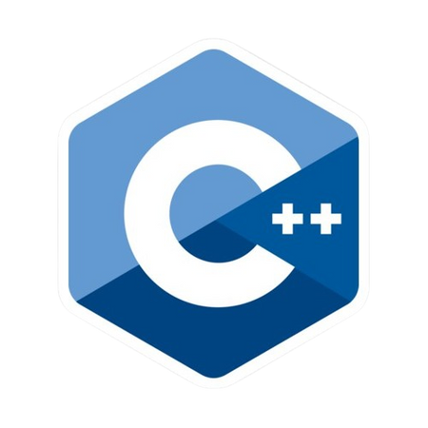
BASIC OF
PROGRAMMING
Presented by Shree Nath Mahato and Suraj Narayan Singh

Slide 2



CONTENTS
Introduction
Installing C++
Sample Program
Comment
Data Types
Operators
Control Statement
Practical Part

Slide 3

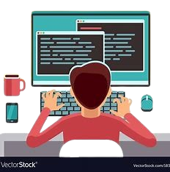
INTRODUCTION
C++ is a powerful, general-purpose programming language known for its speed and efficiency. C++ combines features of C with object-oriented programming, making it a popular choice for complex software development.

Slide 4

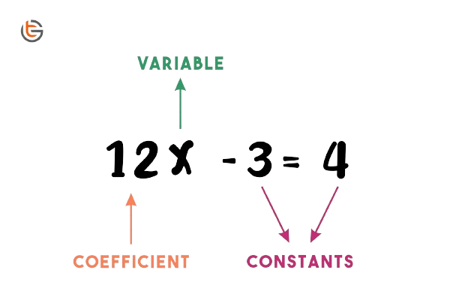

Slide 5



INSTALLING C++
Go To Website
Download MINGW
Open MINGW & install its components
Set Environment Variable
Open code editor & install C/C++ extension

Slide 6

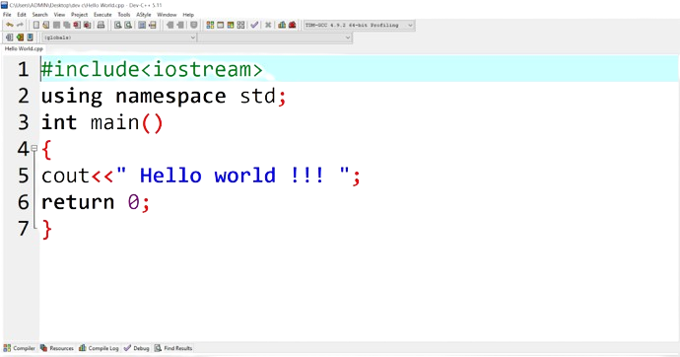




SAMPLE PROGRAM
Preprocessor
Header File
Directives
Cin
Return Type
Used for input
Cout
Terminator
Used for Output

Slide 7


COMMENT
// Single Comment
/* Multiple Line Comment */

Slide 8



DATA TYPES
01
Basic Data Types
Derived Data Types
Int
Array
Float
Pointer
Double
Reference
Char

Slide 9


OPERATORS
Arithmetic operators (+, -, *, /, %)
Relational operators (==, !=, <, >, <=, >=)
Logical operators (!, &&, ||)
Assignment operators (=, +=, -=, *=, /=, %=)

Slide 10

CONTROL STATEMENT
Decision making: if, if-else, switch
Loops: for, while, do-while
Jump statements: break, continue, return

Slide 11

PRACTICAL PART
Remy Marsh

Slide 12

THANK'S FOR WATCHING

